Slide 1
Deal or No Deal
Chris Kazenske, Deandra Diedrick, Nam Nguyen, Orondo Jones

Slide 2
Description
The main objective of the game: Select a case containing a mystery cash amount, then after every 5 cases opened decide whether to take a cash buyout offered (Deal) or reject the offer and continue eliminating cases (No Deal).

Slide 3
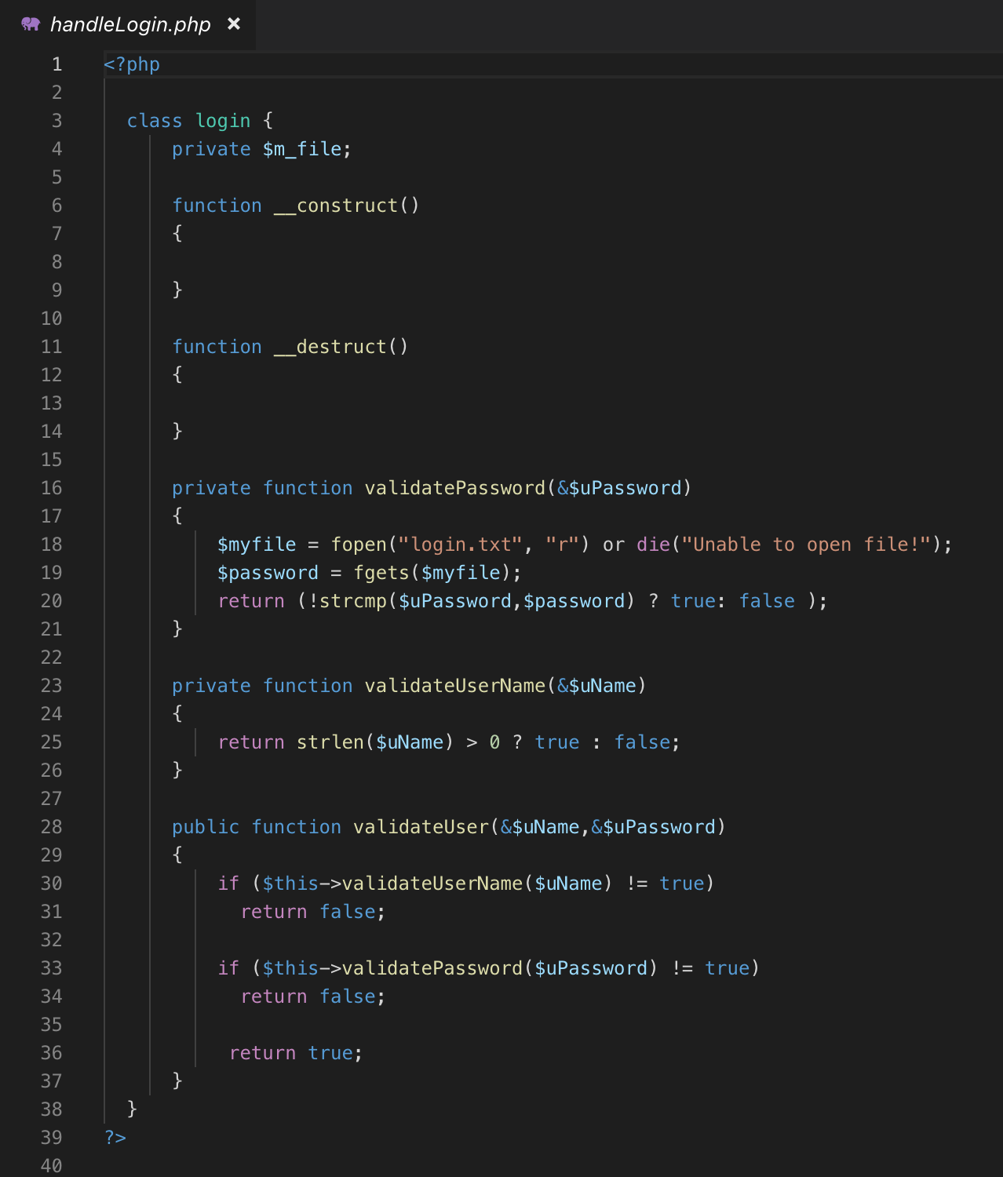
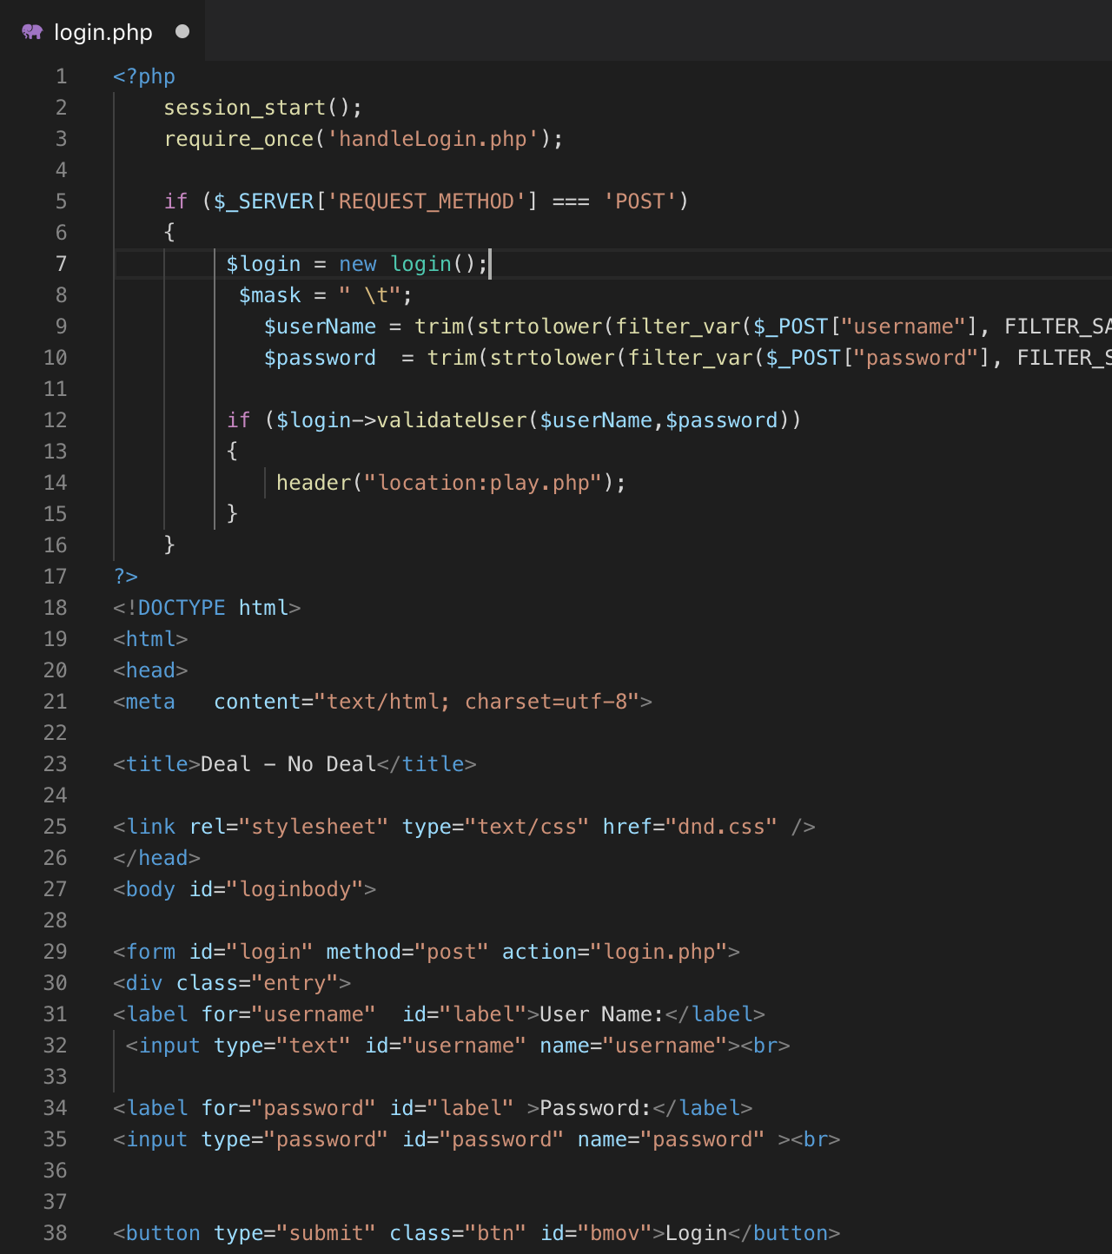
Code Snippets cont.
Login

Slide 4
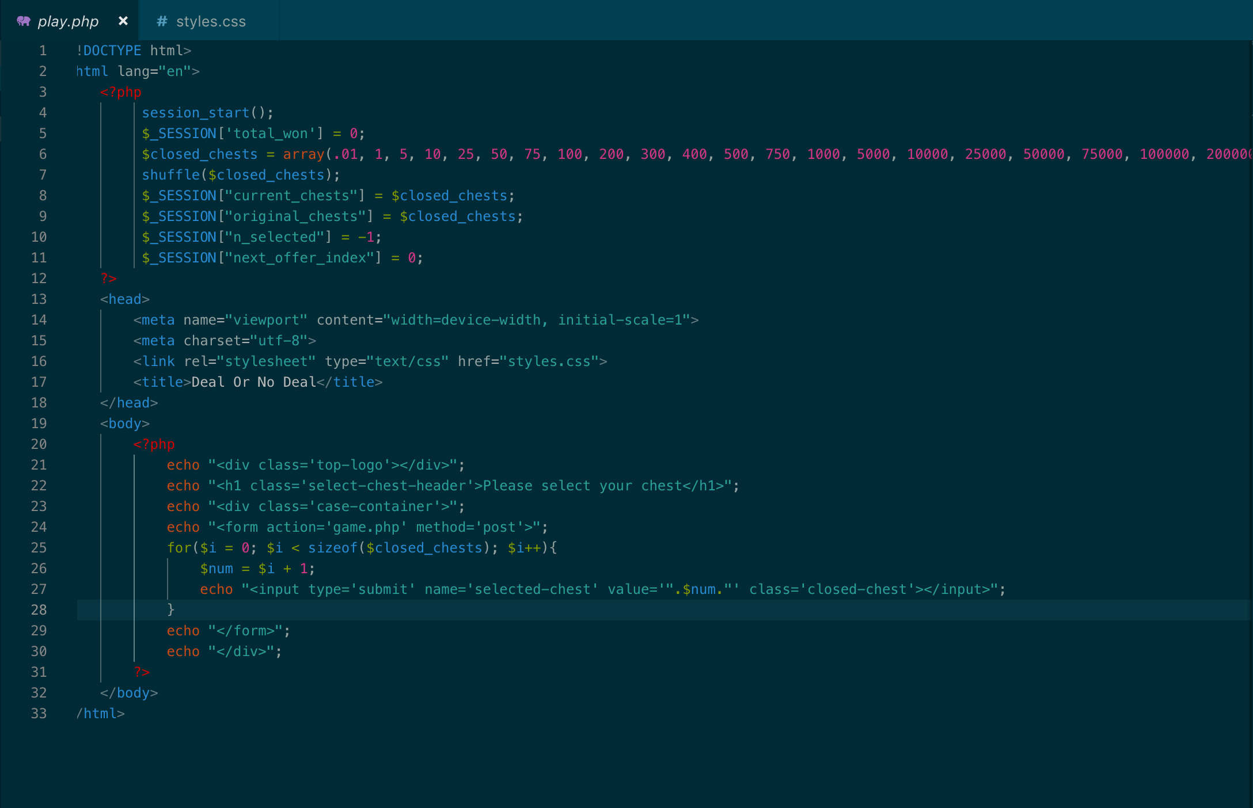
Play screen:
chests

Slide 5
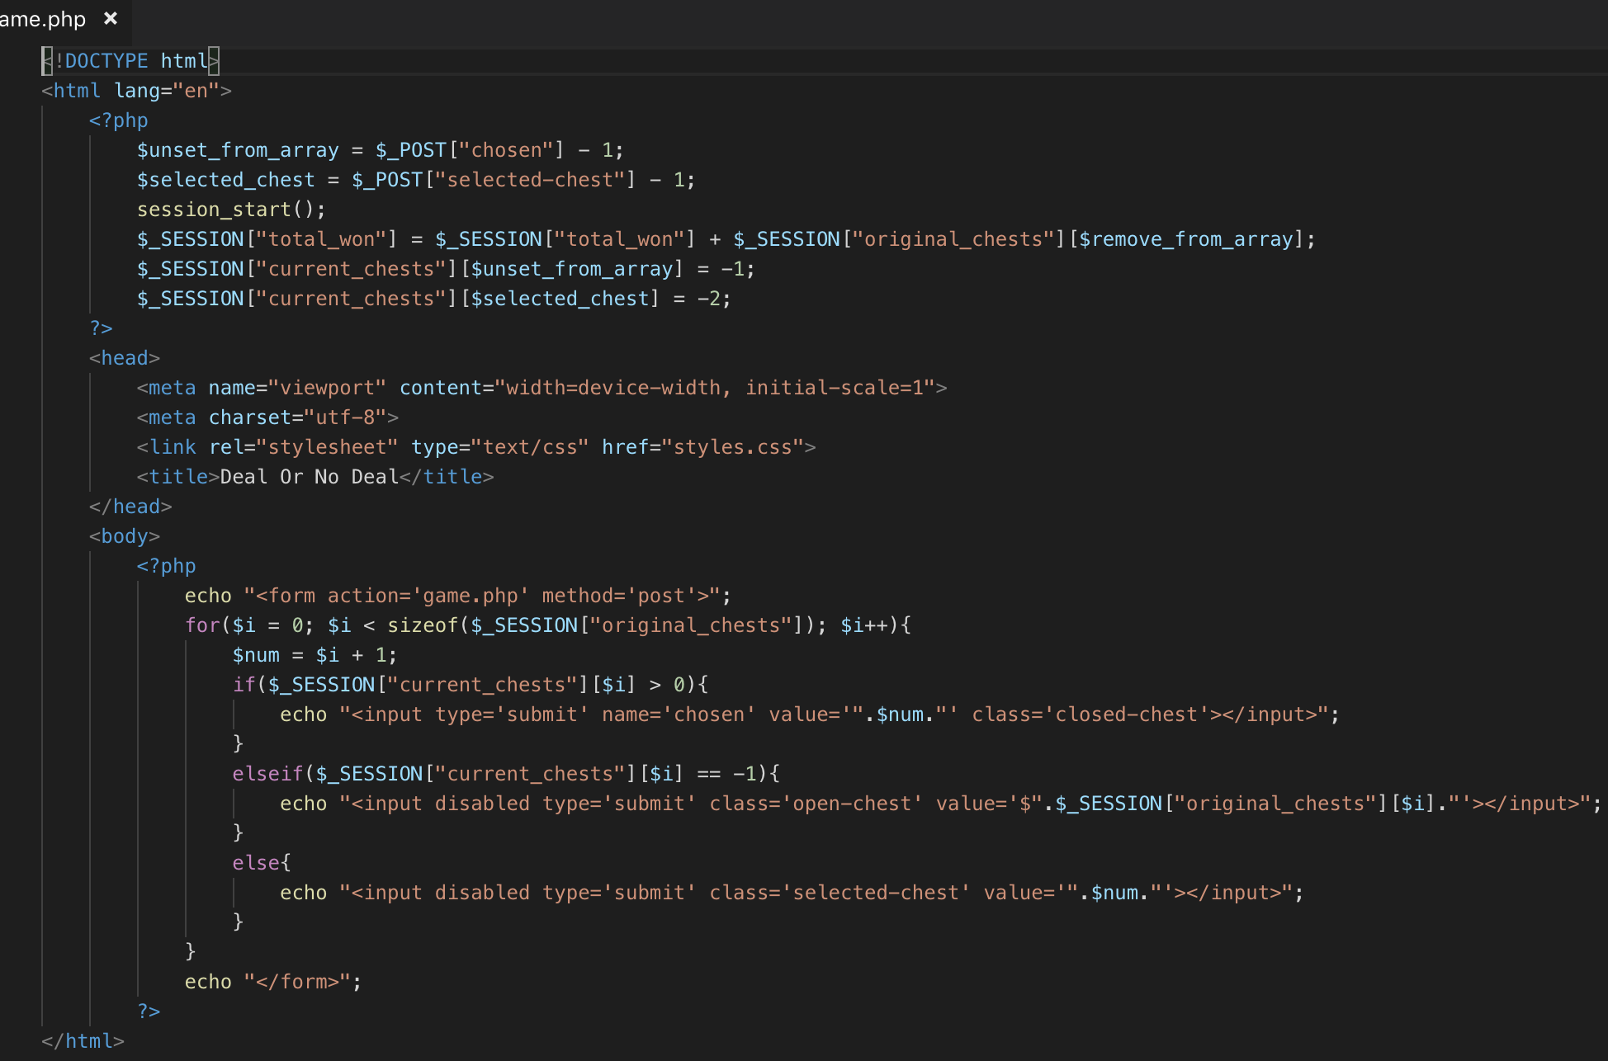
Code Snippets
Game screen

Slide 6
Demo
https://codd.cs.gsu.edu/~ckazenske1/DealOrNoDeal/login.php

Slide 7
Any Questions?

